Slide 1
How to Write a Synthesis Essay
https://youtu.be/HuIMcOu4AeE
Developed by Thomas Scott

Slide 2
The wording of all synthesis prompts in the new AP Language test
Write an essay that synthesizes material from at least three of the sources and develops your position on [specific subject from the introduction].
They’re doing this because they value sophisticated, nuanced examinations of the questions they’re posing in the synthesis and argument prompts:
Synthesis of sources should be a process of authentic inquiry motivated by questions for which readers genuinely want answers, not by desire to affirm preexisting positions. [...] successful synthesis means proceeding with an open mind and finding an array of sources that satisfactorily broadens the context of one’s research question. Part of authentic inquiry is the processes by which students—while they are thinking and reading— determine how the issues they are examining can be viewed from multiple perspectives.
-AP Language Course Description, page 89

Slide 3
Synthesis Rubric
Model Synthesis prompt
The first and most important rule of all AP prompts: read the prompt and answer the question
The best synth essays take a stance while understanding the other side (they will always give you evidence that allows you to take a variety of positions).
Instead of analysis/commentary, you are expected to develop a line of reasoning...

Slide 4
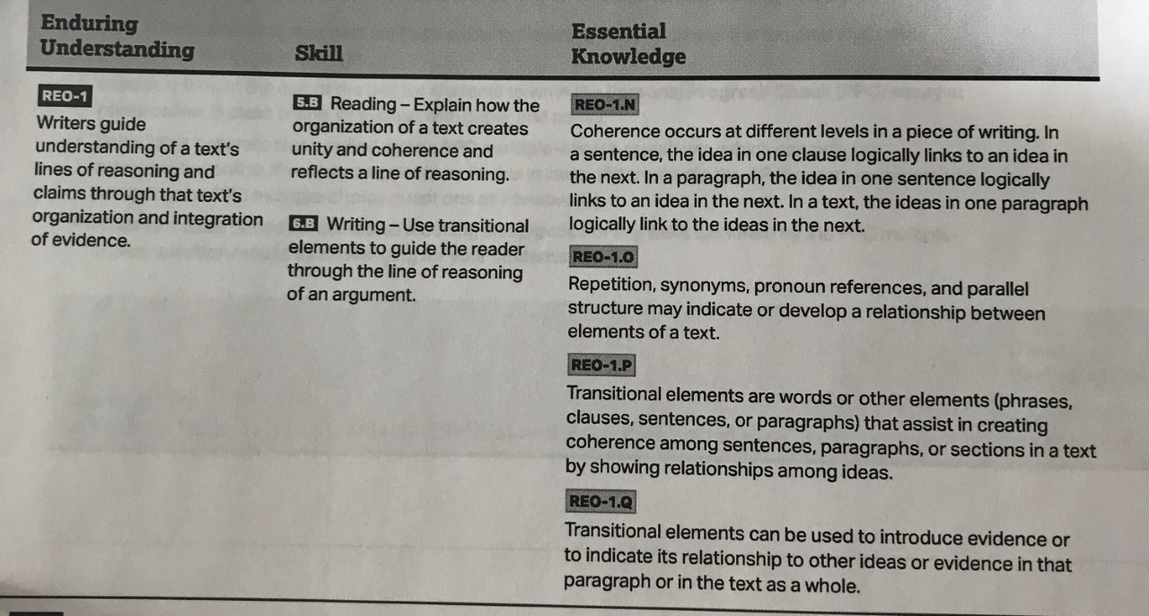
What is a line of reasoning? (from College Board framework…)

Slide 5
Binary vs. Relative
When an issue is binary, there are only two choices. Hence, the bi- prefix.
Binary code is named as such because in it you can either use 0 or 1.
According to College Board, “very few issues involve good/bad binaries; there are benefits to all positions. However, teachers need to help students see that the lack of binaries does not mean all issues are relative. There are degrees of value to all positions that students must weigh to create sophisticated arguments.” (2019 Chief Reader Report)
When an issue is relative, there are degrees of value to all positions that “students must weigh in order to create sophisticated arguments.”

Slide 6
What is a qualified argument?
-A qualified claim is usually more sophisticated than an absolute claim.
*College is not worth it. < absolute, no wiggle room
*For most American teens, college is not worth it.
*For American teens who have to rely on loans to pay for tuition, college is not worth it.
^ the second and third claim are both qualified, which adds a more nuanced perspective on the issue. Nuance = sophistication
-When using sources, always have a quote or mention its content. Many students wrote sentences that did not contain a quote or a reference to the actual source but contained a citation. Don’t do that.
NOT ACCEPTABLE: College is relatively affordable, when you adjust for scholarships and inflation
(Source A).
ACCEPTABLE In his article, Leonhart states the “relative affordability” of college (Source A).
ALSO ACCEPTABLE: Leonhart in the NYTimes writes about the relative affordability of college (Source A).

Slide 7
Qualify these claims....
John Champe is the best high school.
[turn to the person next to you] You are my best friend.
Mr. Scott is the best teacher.
Cell phones shouldn’t be allowed at high schools.
Why is a qualified claim (usually) more sophisticated than an unqualified claim?
How does a qualified argument help make your argument less biased?
What’s the difference between qualification and equivocation?
In what rhetorical situations would you NOT want to qualify a claim?

Slide 8
What are the features of most well-written persuasive essays?
Hook -- some sort of opening that doesn’t just restate the prompt
Setup -- acknowledgement of the context of the essay, leading to your....
Thesis -- Ideally, two or three significant and distinct points that support your position
Meaningful transition: a few words or phrases that connect ideas in prior paragraph to the...
Topic sentence/Claim -- first point from thesis
Evidence -- example (in this case, a source from the packet)
Commentary-- explanation (or “line of reasoning”) of how this example proves thesis. This should be several sentences
Transition: a few words or phrases that lead to...
Evidence #2 -- example (another source from the packet, showing a new perspective on this point)
Commentary -- explanation (or “line of reasoning”) of how this example proves thesis
Synthesis -- tying together the ideas present in both examples
Opening paragraph
Body paragraphs

Slide 9
How about the conclusion?
Conclusion: Look to what the future holds for the issue being discussed in this prompt. Most questions deal with issues that are in flux, so use this space to comment on how the issue may evolve based on the evidence. Or, situate the argument in a broader context. Reassert your thesis without simply restating it. Also, if you haven’t acknowledged concessions (points that go against your thesis), you might mention them here

Slide 10
Model Synthesis prompt
Model Synthesis essay

Slide 11
2019 Synthesis prompt
2019 Synthesis sample student responses

